Slide 1
REJECTION RESILIENCE
KAREN B. K. CHAN

Slide 2
opening
Rhythmic introductions!
Name
Pronoun(s)
What kind of animal would you be?

Slide 3
SHARING
Failure is…
How you liked to play as a kid

Slide 4
Cultivating COURAGE
Recognize it is not (necessarily) heroic
Practice
Recognize your courage (action or intention)
Plan your courageous acts
Imagine courage even if you don’t follow through
Don’t overthink

Slide 5
Rejection
Emotional injury is like physical injury
Requires attention and care
What’s your relationship to the pain of rejection?
Naming it, removing masks – what reactions mask your pain?
“Truth resilience”
Adjust expectations – it’s supposed to happen

Slide 6
ATTACK SELF
ATTACK OTHERS
FIGHT
ZONES
COMFORT
STRETCH
FLIGHT
PANIC
WITHDRAW
AVOID

Slide 7
SCENARIO 1
You have great rapport with someone on campus; running into each other for months. You’d like to take them on a date, but you don’t know if they’re into dating, available, or into you.

Slide 8
SCENARIO 2
You and your friends all apply to work as a convenor for exams. It’s 2 weeks of part-time work and it makes great money.
You find out that your friends all got accepted but you didn’t.

Slide 9
SCENARIO 3
You are at a multi-day retreat and really hit it off with someone. Every night, when the other attendees have gone to bed, you two take long walks and chat late into the night while watching stars on a hill. On the last night, it’s obvious you’re going to kiss. You make the move. They move away saying, “Oh no. You… misunderstand. I’m not…”

Slide 10
GUILT
Panic Zone
You’re not responsible for everyone else
Are you compromising your needs to fulfill someone else’s?
People are resilient; believe it
Tell the truth about yourself

Slide 11
SCENARIO 4
You are at a convenience store. The cashier looks like they are new, and the store’s owner is watching them like a hawk. You buy some cucumbers. The cashier shortchanged you by 10$.

Slide 12
SCENARIO 5
You are invited to join a book club by an acquaintance. This person treats you very well but you don’t like how they treat other people. You don’t want to join.

Slide 13
SCENARIO 6
You are about to go on a date with someone you’re excited about. The plan is they are going to pick you up at home, then go to the movies.
Shortly before the date arrives, your best friend shows up at the door. They are recently single. They’re feeling bored and wants to hang out. You say, “Oh, damn, I have a date tonight”.
Your date arrives, chats with your best friend while you feed the cat. When you rejoin them, the date reluctantly says, “Well, I mean, you can join us...? I don’ t mind” and looks at you.

Slide 14
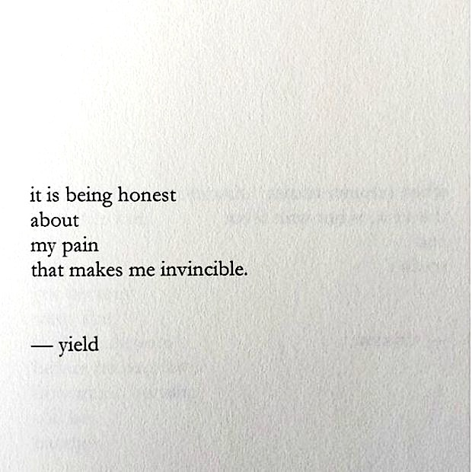
@karenbkchan
nayyirah waheed

